Slide 1
Big Data Project: Yelp Fake Reviews Detection
Team
Nigist Woldeeyesus
Ghita Moummi
Vineetha Oppula

Slide 2
Yelp Fake Reviews Detection
Problem statement:
Yelp is a widely used software that publishes reviews about businesses across the united states.
Online spam reviews are misleading evaluations of products and services. This often carried out as a deliberate manipulation of users’ judgments and decisions.
Our goal in this project is to predict if a given review is fake or real, based on the content from Yelp reviews dataset.

Slide 3
About the Dataset…
We used two different dataset:
Classified/labeled yelp review dataset (http://odds.cs.stonybrook.edu/yelpzip-dataset/)which we used to train and build machine learning model.
Contains data from for year 2014-2010 for total of 608458 reviews.
Contains 80466 fake reviews and 528,132 true reviews
Yelp dataset (https://www.yelp.com/dataset.) Json files which contains information with respective of review content, user id, product id, date of the review, and the rating given by the user to the product.

Slide 4
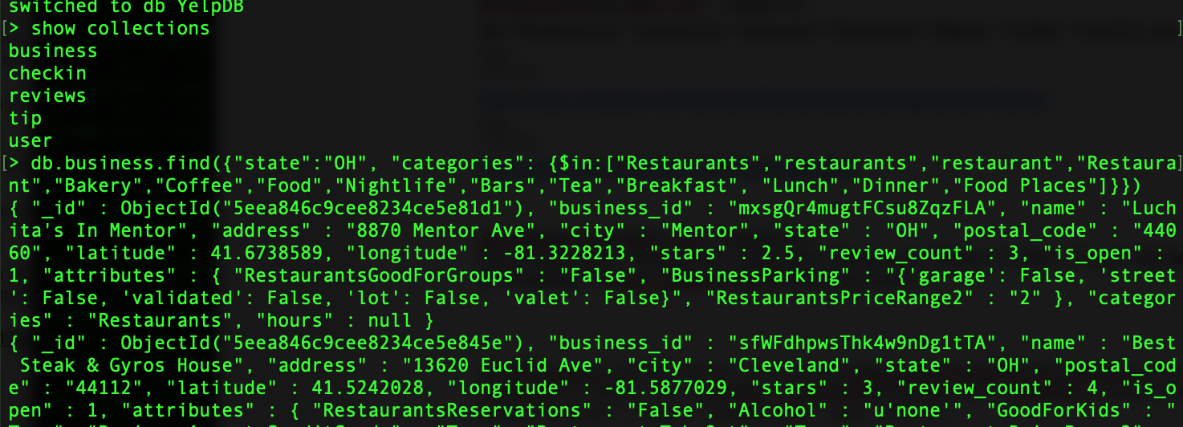
Implementation
For this project we have implemented the following techniques:
Data extraction and transformation
Data storing(MongoDB)
Preprocessing /Feature engineering
Machine Learning model
Data Visualization
Sample data from MongoDB:

Slide 5
Data Flow/Architecture Diagram

Slide 6
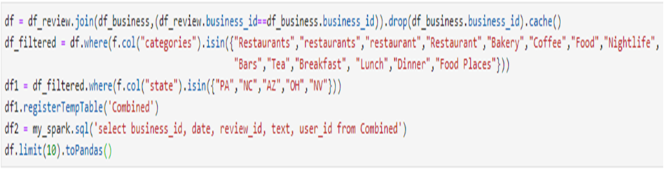
What is not implemented:
Alternatives:
Connected MongoDB to Python (jupyter) and used pyMongo.
Exported filtered data as a CSV file and uploaded it to Google Colab
Implementing Spark: show()/ toPandas() commands were unresponsive due to computational power limitations.
Connecting our Google Colab notebook to MongoDB:
The local MongoDB cannot be connected to Google Colab.
The MongoDB cloud free version only offers about 500MB storage for trial.
SparkSQL queries that we attempted to run

Slide 7
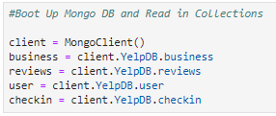
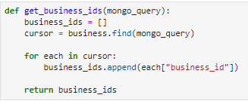
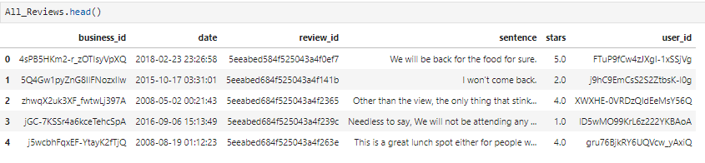
Data Preprocessing- yelp reviews
We have loaded the data from MongoDB directly to pandas dataframe using pymongo library and got the final dataframe ready to apply our machine learning model on.
Establishing MongoDB Connection with Python
Pymongo queries to filter our dataset
Final dataframe to apply our ML model on:

Slide 8
Data Preprocessing- labeled dataset (ML)
Merging datasets: ReviewContent and metaData
Checking missing values
Text Processing
Removing Stop words e.g., "a," "the," "of," "I," .., Punctuation, Special characters
Lowercase the review text
Vectorization: Transformed text into vector representations so that we can have numeric values for machine learning.
Resolved imbalanced data by replicating the existing sample. The count of True reviews is almost 7 times higher than the count of fake reviews.

Slide 9
Models and Methods
We used the top 3 sentiment analysis models below to train our text:
Multinomial Naive Bayes: Generative model; The label is generated from a Bernoulli distribution. Given the label, the frequency of each word in the dictionary is generated from a multinomial distribution (n = length of text).
Convolutional Neural Network(CNN): 5 hidden layers with “ReLU” activation followed by sigmoid activation and dropMaxPooling1D, Flatten, Dense.
Support Vector Machine(SVM): separation of classes
Models Results Summary:
Models | Accuracy
 | Training | Test
CNN | -- | 86%
MNB | 84.4% | 80.3%
SVM(Best) | 99% | 92.0

Slide 10
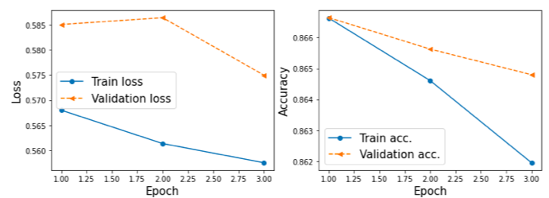
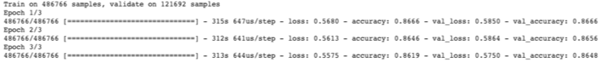
Convolutional Neural Network (CNN)
Our CNN model was inconsistent. It showed decreasing accuracy for both the training and test sets. We are assuming this is due to overfitting. We tried to add a drop() layer which makes the model simpler to overcome overfitting. However, we still had the same trend of decreasing accuracy. The highest accuracy was 86%

Slide 11
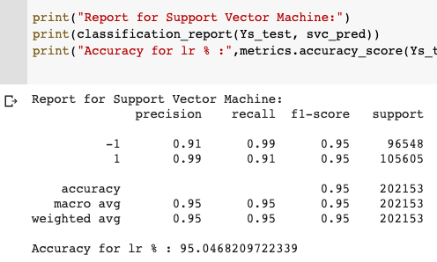
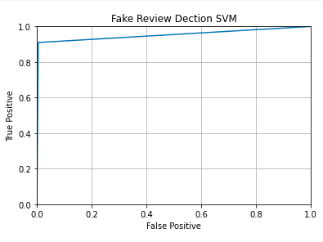
Support Vector Classification (SVM)
•Our SVM model showed a 95% accuracy, it means there is 95% chance that model will be able to distinguish between positive class and negative class.
•SVM had the highest accuracy and so we chose it to run our predictions on yelp reviews.

Slide 12
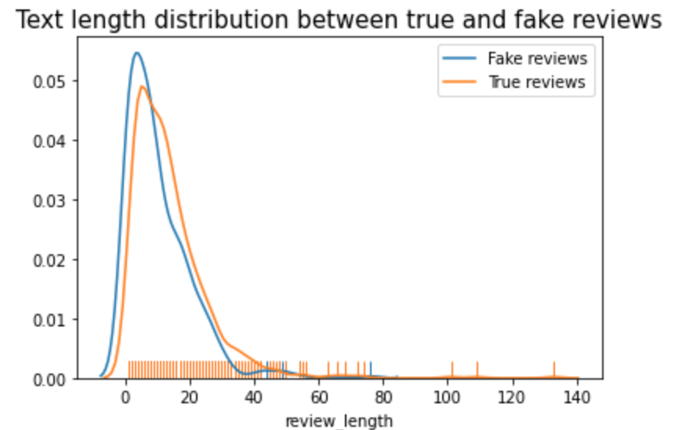
Visualizations
At this point, we have applied our best trained model (SVM) on the reviews we retrieved from yelp and filtered through pymongo.
We get our prediction (True or Fake) on yelp dataset and we perform the following visualizations.
Visualization 1: Text Length distribution
There was no apparent text length distribution difference between true and fake reviews

Slide 13
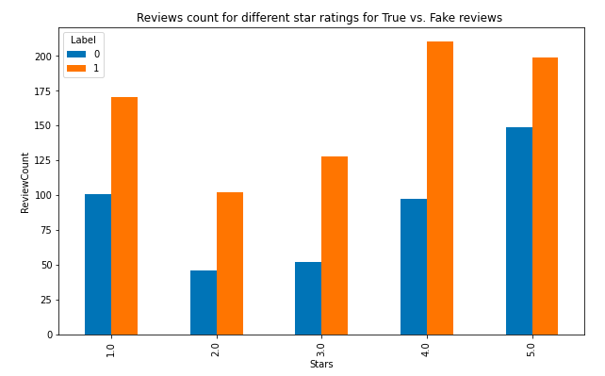
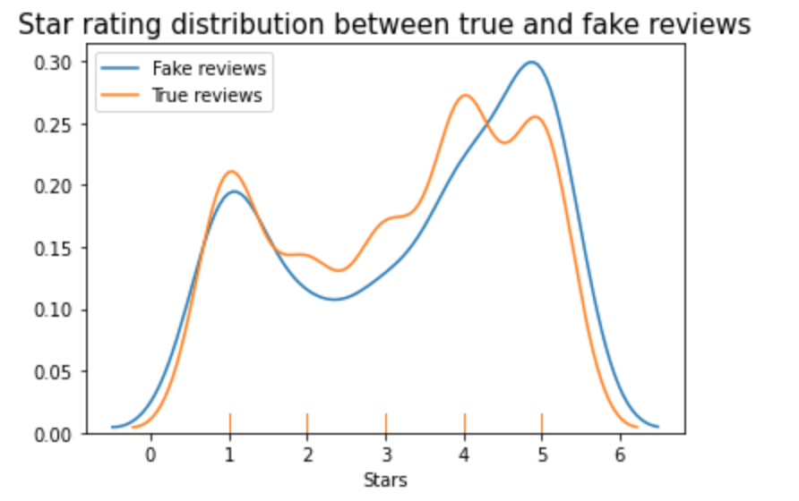
Visualizations- continued
Visualization 2: Star ratings distribution for true vs. fake reviews
There is no difference in star ratings distribution between true and fake reviews

Slide 14
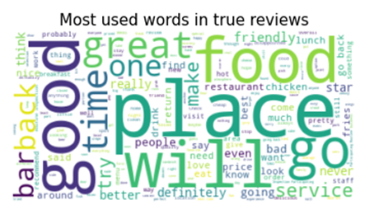
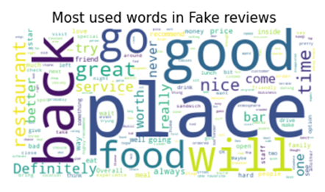
Visualizations- continued
Visualization 3: Most used words in true vs. fake reviews

Slide 15
Conclusion & What we have learned from the project:
Conclusion:
SVM worked best for sentiment analysis.
It is hard to classify a true or fake review by looking at it. We must run it through the model.
What we have learned from this project:
How to use big data tools: Apache Spark, Pyspark, MongoDB, Pymongo
How to connect MongoDB to python
How to connect MongoDB cloud to Google Collaborate
How to run queries using SparkSQL and Pymongo

Slide 16
Sources
https://www.yelp.com/dataset
http://odds.cs.stonybrook.edu/yelpzip-dataset/
https://keras.io/api/preprocessing/text/
https://www.pluralsight.com/guides/data-visualization-deep-learning-model-using-matplotlib
https://github.com/zzhang83/Yelp_Sentiment_Analysis/blob/master/Scripts/Machine%20Learning.ipynb
https://towardsdatascience.com/naive-bayes-document-classification-in-python-e33ff50f937e
https://scikit-learn.org/stable/modules/generated/sklearn.feature_extraction.text.CountVectorizer.html
https://github.com/rasbt/python-machine-learning-book-3rd-edition/blob/master/ch15/ch15_part1.ipynb
https://towardsdatascience.com/cnn-sentiment-analysis-1d16b7c5a0e7
https://machinelearningmastery.com/use-word-embedding-layers-deep-learning-keras/#:~:text=The%20Embedding%20layer%20is%20initialized,used%20in%20another%20model%20later
https://towardsdatascience.com/machine-learning-nlp-text-classification-using-scikit-learn-python-and-nltk-c52b92a7c73a
Thank You!

